Slide 1
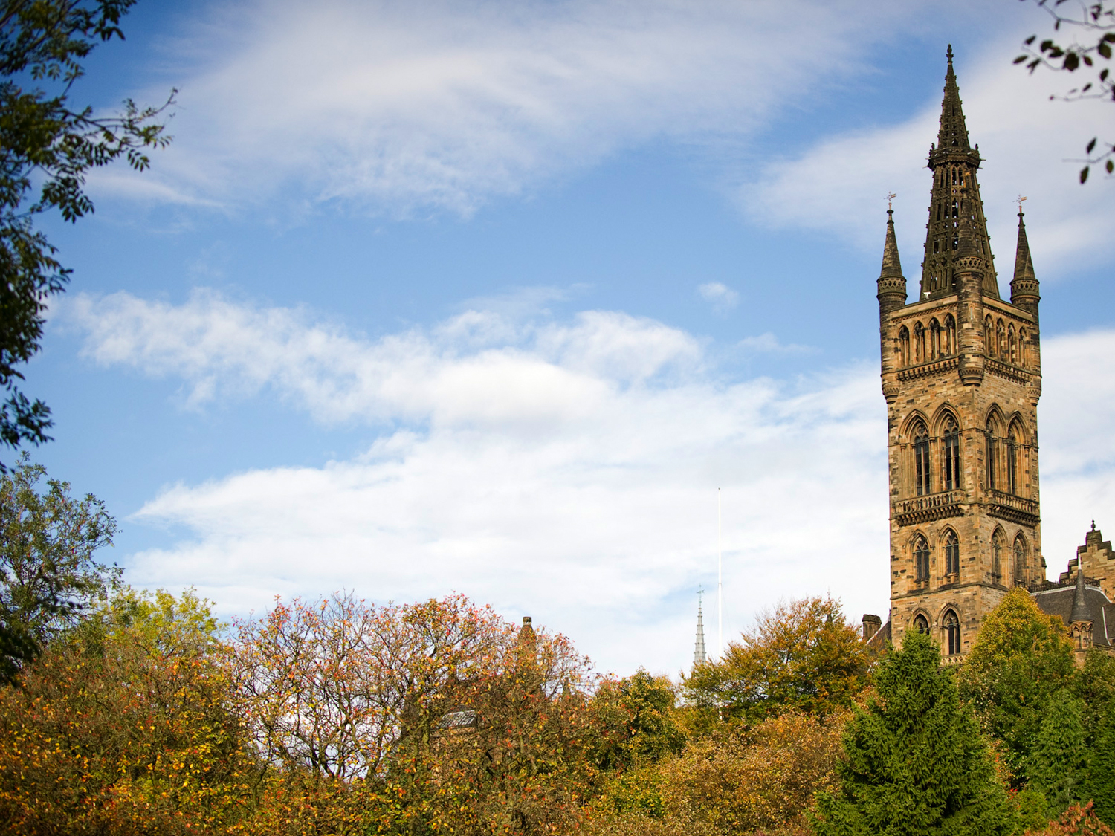
Reflexions on the western tradition: what is it and does it matter?
Penny Enslin
21 October 2022

Slide 2
THE CURRENT CRISIS OF THE WEST
The war in Ukraine
The end of democracy?
Economic decline
Inequality between and within nation states
Climate catastrophe

Slide 3
A CRISIS ALSO BROUGHT TO THE FORE BY:
Postcolonialism and the decolonial critique of the West
Black Lives Matter
Activism about memorials

Slide 4
MOHANDAS GANDHI ON WESTERN CIVILIZATION (attributed)
‘Mr Gandhi, what do you think of western civilization?’
‘I think it would be a good idea’

Slide 5
WHAT IS THE WESTERN (NORTHERN?) TRADITION? VIEW (1)
Competitive
Exploitative
Violent
Elitist
Materialistic
Individualistic
Rational
Linear
Empirical
Mechanistic
Masculine

Slide 6
THE WEST? VIEW (2)
‘The survival of the West depends on Americans reaffirming their Western identity and Westerners accepting their civilization as unique not universal and uniting to renew and preserve it against challenges from non-Western societies.’ (Huntington, 1997: 20-21)

Slide 7
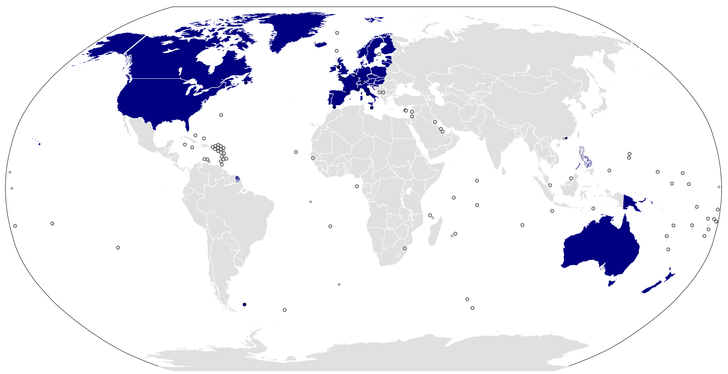
WHAT/WHERE IS THE WEST? wikimedia.org/wikipedia/commons/3/37/Western_world_Samuel_P_Huntington.svg

Slide 8
DEFINING THE WEST
A contested concept
Home of modernity?
Historically, defined by a largely Christian heritage
Separation of church and state

Slide 9
THE WEST: ATTRIBUTED FEATURESS
Social pluralism
Representative government
Democracy
Rule of law
Individualism

Slide 10
A LOT TO ANSWER FOR (1)
Imperialism and colonialism
Slavery
Marginalization of indigenous people, plunder of resources and land, genocide, impoverishment

Slide 11
A LOT TO ANSWER FOR (2)
Role of western science and technology in environmental destruction
Violence of two world wars
Threat of nuclear annihilation

Slide 12
THE IDEA OF THE WEST: A CRITICAL APPRAISAL
A useful concept
A diverse history
Addressing colonial legacy
Getting universality right

Slide 13
DEFENDING THE WESTERN TRADITION
Features worth defending but not exclusive to the West:
  Reason
  The individual
  Freedom and equality
  Democracy
  Human rights

Slide 14
THE WEST WAS NEVER ONE (1)
Historically, Christianity has been dominant, yet it
  is neither Western in origin,
  nor internally homogeneous,
  nor the only influential major religion,
  nor a monopoly of the West.

Slide 15
THE WEST WAS NEVER ONE (2)
An increasingly diverse West
The West is not a unified agent with a collective purpose

Slide 16
THE WEST WAS NEVER ONE (3)
Not all Western countries were colonial powers
Not all imperial powers are western
An increasingly hybrid West

Slide 17
THE WEST WAS NEVER ONE (4)
Colonialism has been critiqued from a range of western theoretical traditions, including postmodernism, postcolonialism, critical theory, feminism, Marxism…

Slide 18
THE POSTCOLONIAL CRITIQUE
Analyzes ‘the experience of foreign political, cultural, and economic domination as a salient issue and draws attention to the legacies of this history in the present.’ (Kohn, 2010: 203, emphasis added)

Slide 19
THE WEST AND THE REST
The West can and should retrieve and defend the best of its traditions, rejecting a hypocritical universalism and acknowledging its failings within and without.

Slide 20
THE WAY FORWARD
Addressing colonialism and neo-colonialism
Resisting neo-liberalism
Defending democracy

Slide 21
IMPLICATIONS FOR EDUCATION
Countering monetization, marketization
Defending education as a public good
Decolonizing curricula
Critical autonomy as an aim of education
Global justice

Slide 22
REFERENCES
Enslin, P. & Horsthemke, K. (2015) Rethinking the ‘western tradition’. Educational Philosophy and Theory 47(11).
Gopal, P. (2019) Insurgent Empire. Anticolonial resistance and British dissent. Verso.
Holland, T. (2019) Dominion. The making of the western mind. Little, Bown.
Huntington, S. (1997) The clash of civilizations and the remaking of world order. Simon & Schuster.
Kohn, M. (2010) Post-colonial theory. In: Bell, D. (ed) Ethics and world politics. Oxford University Press.

